Slide 1


Quantum Communications Group
DISCRETION - D3.1: SDN Preliminary Design Report - KML
Group Coordinator:
Armando Nolasco Pinto
anp@ua.pt
Group Websites:
https://www.it.pt/Groups/Index/72
LinkedIn: https://www.linkedin.com/company/quantum-communications-group-it-av/
Diogo Matos

Slide 2
DISCRETION SYSTEM OVERVIEW

Slide 3
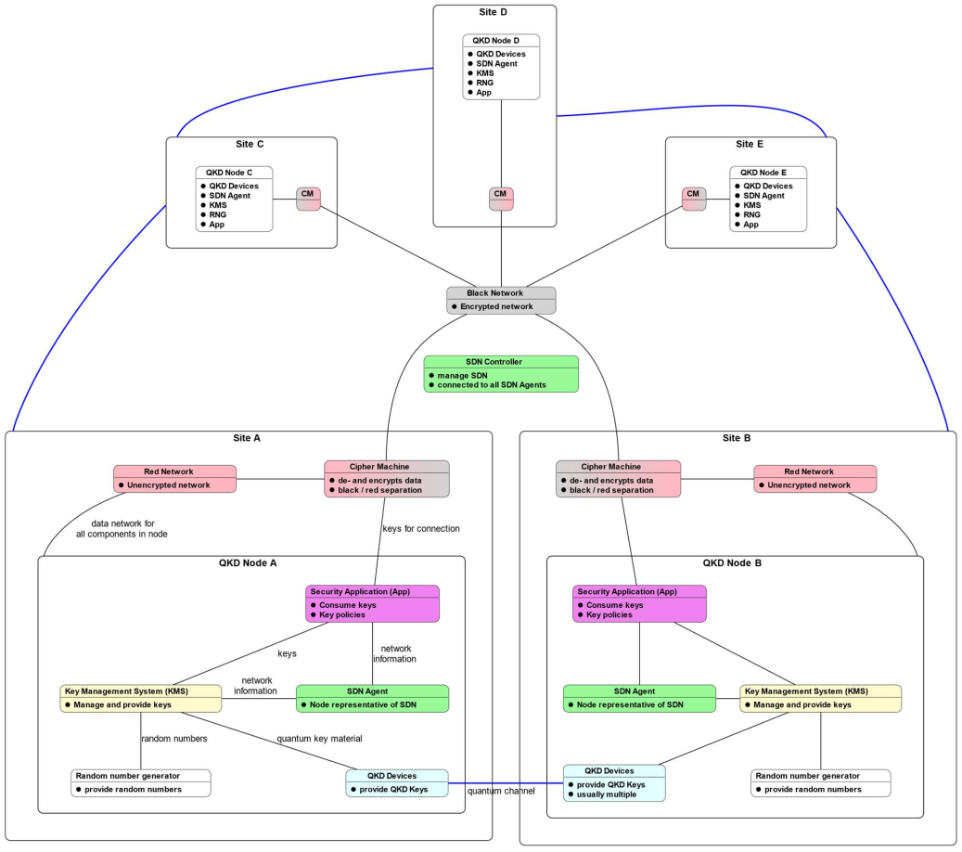
multiple identically structured nodes all connected by a encrypted network managed by the SDN Controller;
each QKD node has multiple interfaces, applications, capabilities and key association (quantum) links;
each node has a SDN Agent representing the SDN Controller locally;
each node has a QKD Key provider and random numbers generator;
each node has a Key Management System(KMS).

Slide 4
KMS main features
Receive the symmetric key material generated by the QKD modules;
Store key material, metadata and other keys such as pre-shared keys (PSK);
Manage the stored key material;
Derive keys from QKD key material;
Provide keys to the applications;
Relay key material through the QKDN to remote peers;
Interact with SDN;
Authenticate peer KMSs, apps and other directly connected components;
Synchronize with peers;
…

Slide 5
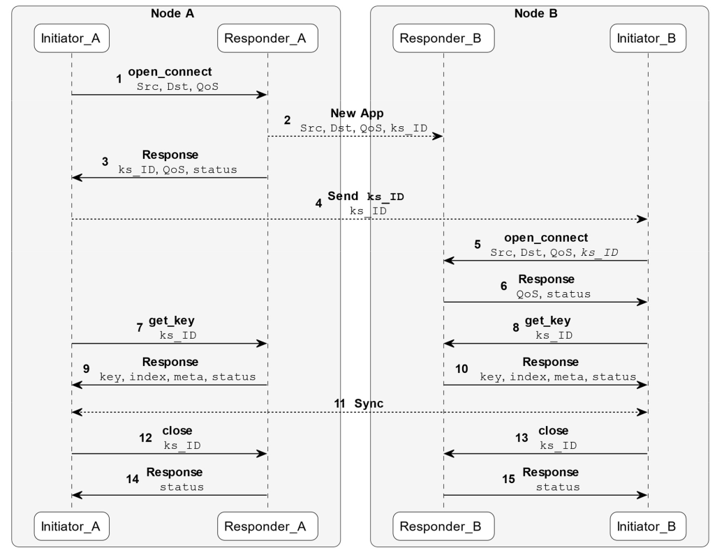
Key material retrieval
The KMS is connected to one or more QKD modules;
The interface between the two can be push or pull based. Push based means the QKD module sends the key material right after its generation. In a pull based interface, the KMS need to make a request in order to get key material;
Both modes can follow the ETSI QKD GS 004 standard.
Outlined protocol in a two node scenario

Slide 6

Key material storage and management
The KMS has a database to store different kind of keys or key material;
Each key or key material has metadata attached to it, such as UUID, state, creation time, identification of the peers, etc;
The database stores key pre-shared keys as well. These are used during bootstrap to secure the initial inter KMS communication when no QKD key material is available;
The KMS implements a key lifecycle management as well key synchronization between peers (both when receiving key material and when provisioning it);

Slide 7
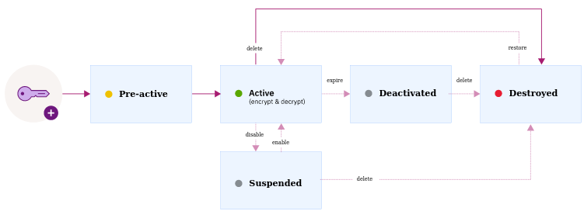
Typical key lifecycle
https://cloud.ibm.com/docs/key-protect?topic=key-protect-key-states for more info

Slide 8

Provide keys to applications
The KMS implements an ETSI QKD GS 004 compliant interface based on three low level calls:
OPEN_CONNECT - Reserve an association (Key_stream_ID) for a set of future keys at both ends of the QKD link and establish a set of QOS parameters.
CLOSE - Terminate the association established for this Key_stream_ID.
GET_KEY - Obtain a specific amount of key material for a given Key_stream_ID.
An additional ETSI QKD GS 014 interface might be built on top of the previous making the calls more accessible and abstract to Secure Applications developers

Slide 9
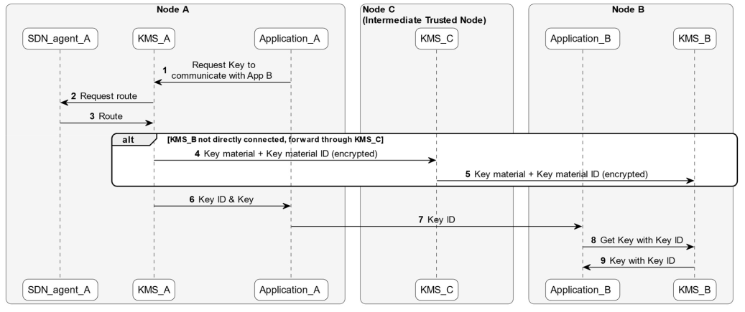
QKDN key relay
Since the QKD devices only generates symmetric key material between two directly connected devices, it must be a way to propagate keys between two arbitrary nodes;
The source node derives a key to be relayed from the RNG and uses the QKD generated key material to protect it using Information-Theoretic Security (ITS) algorithms such as OTP;
This relay process is very susceptible to create a overload in the network. To mitigate that, the SDN Agent of the source node (with help from the SDN controller) calculates the optimal relay route and notifies all intermediate trusted nodes.

Slide 10
KMS FUNCTIONAL MODULES

Slide 11
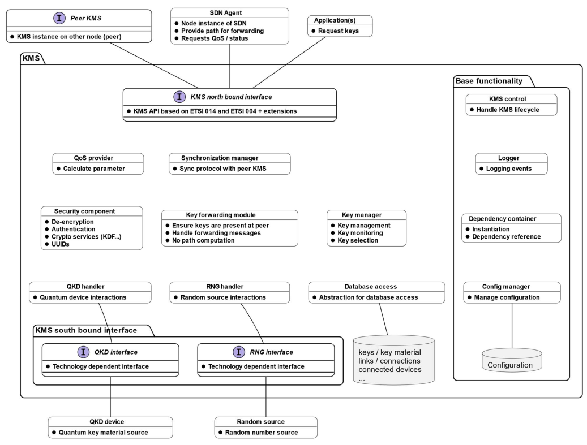

Slide 12
QKD North Bound Interface:
ETSI 004 based interface to the applications;
SDN Agent interaction;
Inter KMS communication (for auth, sync and key relay).
QoS provider:
Gathers and calculates all parameters required for QoS information.
Synchronization manager:
Handles the synchronization protocol with the peer KMS;
Since all keys must be in sync with between peers, this module is used in almost all features.
Security module:
Implements all cryptographic algorithms used during operation of the KMS;
This includes the ITS algorithms such as Key combination and Wegman Carter authentication as well as Post Quantum Cryptography algorithms.

Slide 13
Key Forwarding Module:
Handles the key relay process.
Key manager:
Maintains and handles the keys;
Is mainly used for key material retrieval, storage, etc.;
It’s involved in any activity related with keys (almost all).
Device handler:
Handles both the RNG and QKD device using/implementing their interface;
Database interface:
Handles all direct interactions with the database;
Used everytime key material entry is stored, retrieved, modified or deleted. It also has information stored about other components such as connected devices.
Base functionality:
Handles several quality-of-life features such as logging and configuration.

Slide 14
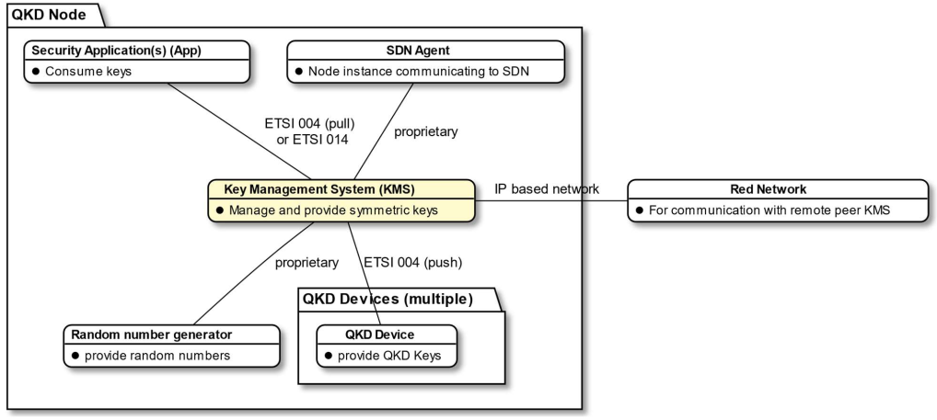
KMS Interfaces
* For setup and maintenance such as modifying the amount and type of connected devices for example, but also to update pre-shared keys, a maintenance interface is required too.

